Slide 1
Floodplains & Highways
Susan Jones/Joe Krolak
FHWA Office of Bridges and Structures - Hydraulics

Slide 2
Disclaimer
Except for the statutes and regulations cited, the contents of this presentation do not have the force and effect of law and are not meant to bind the States or the public in any way.
This presentation is intended only to provide information regarding existing requirements under the law or agency policies.
Sources: USGS, Upper Mississippi River Floodplain

Slide 3
What is a floodplain?
“A lowland area adjoining inland and coastal waters which are periodically inundated by flood waters, including flood-prone areas of offshore islands.”
USDOT Order 5650.2
Notes:
The USDOT Order 5650.2 Floodplain Management and Protection has a definition for floodplain and it reads:

Slide 4
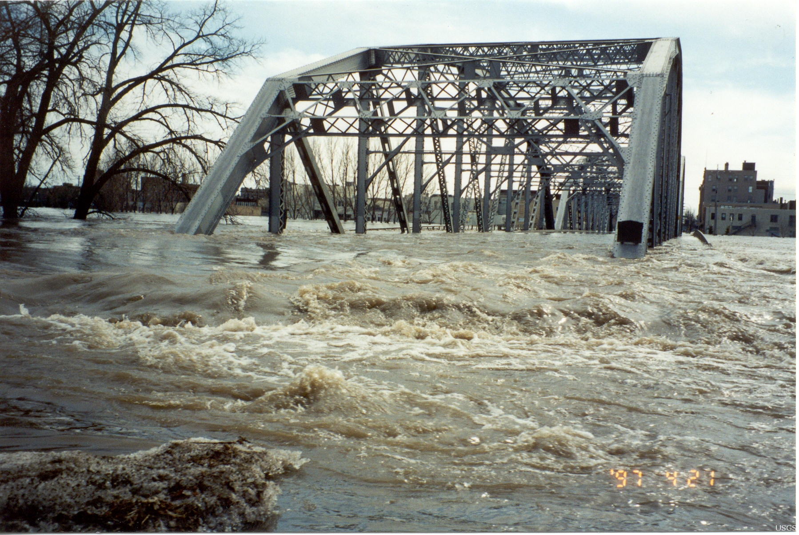
Why should we care?
Executive Order 11988, Floodplain Management (1977)
Reduce flooding
Minimize impact of flooding
Restore or preserve floodplain values
Sources: FEMA, Aerial of washed out road in Wisconsin;
USGS, Grand Forks flooding on Highway 2, 1997
Notes:
There are plenty of precedent policies and EO, but I’ll focus on one of the most recent applicable one: President Carter’s EO 11988 on Floodplain Management. EO 11988 superseded EO 11296 (1966 – President Johnson). It requires federal agencies to develop floodplain management policies to: reduce flooding, minimize impact of flooding and restore or preserve floodplains values.
Ok, and ? What does that mean?
Well, it integrated Planning, NEPA and Floodplains. And as a stakeholder to comply with NEPA, you have to consider avoidance of floodplains and floodplain risks as an alternative
This EO told the federal agencies what to do, but not how to do it.

Slide 5
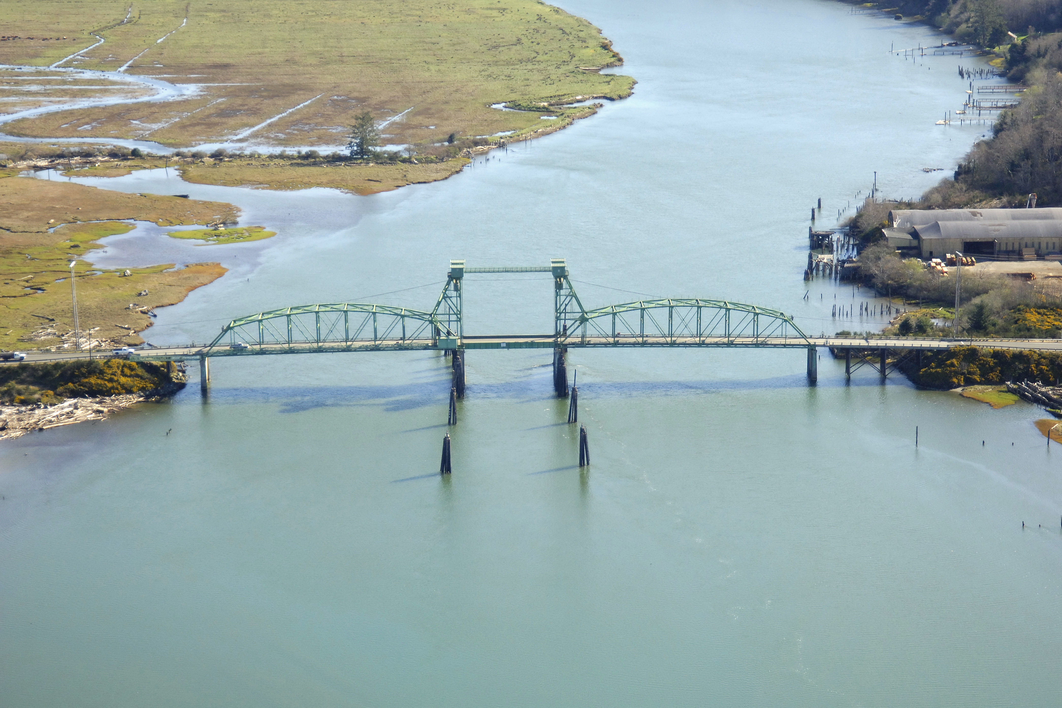
DOT Order 5650.2
Policy
Definitions
Floodplain Identification
Public Review
Environmental Review Process
Source: Marinas.com, Hwy 101, Coquille River Lift Bridge in Bullards, OR
Notes:
The DOT Order is the USDOT’s compliance with EO 11988. The order applies across all DOT modes and allows each mode or agency to come up with their own process for floodplain compliance.
It sets the policy and procedure for ensuring that proper consideration is given to the avoidance and mitigation of adverse floodplain impacts.
It provides:
Definitions related to floodplains (terms such as base flood: flood having 1% chance of being exceeded, 100 yr flood, base floodplain: area inundated by a base flood, encroachment: action within limits of a base floodplain)
Applicability: Order applies to all actions affecting base floodplains
Floodplain Identification: identification of base floodplain limits and delineating encroachments
Public Involvement: early public review and comments
Environmental Review Process: Environmental review documents shall cover for all alternatives involving encroachment: (1) any risk to or resulting from action; (2) impacts on natural and beneficial floodplain values; (3) degree to which the action provides direct or indirect support in the base floodplain

Slide 6
2323 CFR 650 Subpart A – Location and Design of Encroachments on Floodplains
Policy
Location Hydraulic Studies
Only Practicable Alternatives
Design Standards
Content of Design Standards
Notes:
The DOT Order is the USDOT’s compliance with EO 11988, but how does FHWA comply with EO 11988?
Well, we updated 23 CFR 650 Subpart A – Location and Hydraulic Design of Encroachments on Floodplains. The purpose is to prescribe FHWA policies and procedures for the location and hydraulic design of highway encroachments on floodplains, including direct FHWA projects. What makes roadways unique is that it’s a linear transportation system crossing multiple jurisdictions and multiple watersheds.
23 CFR 650 Subpart A consists of: Policy, Location Hydraulic Studies, Only Practicable Alternatives, Design Standards, and Content of Design Standards
Keep in mind that EO 11988 only applies to the first 3 boxes. For those NEPA delegated states, you can only delegate Boxes 2 and 3. Design Standards and Content of Design Standards are not part of NEPA and cannot be delegated.
The big issue in FHWA associated documents is that we have noticed the floodplain section referring to EO 11988 instead of properly citing 23 CFR Subpart A.
If a State DOT is utilizing federal aid eligibility and preparing a NEPA document, it has to ensure compliance with 23 CFR 650 subpart A. The risk of keeping the EO reference is that it opens the State DOT to potential Water Resources Council Guideline requirements that FHWA’s 23 CFR subpart A resolved by using a different approach (e.g., significant encroachment versus critical action). Also, EO 11988 does not reference backwater criteria; that standard is in FEMA NFIP regulation 44 CFR.

Slide 7
Definitions
Base flood: flood or tide having a 1% chance of exceedance in any year (100 yr flood)
Base Floodplain: area subject to flooding by the base flood
Encroachment: action within the limits of the base floodplain
Source: Wendy Hicano, FHWA, 2024
Notes:
Here are some definition defined in 23 CFR 650 Subpart A:
Regulatory floodway: flood-plain area that is in an open manner by Federal, State or local requirements, i.e., unconfined or unobstructed either horizontally or vertically, to provide for the discharge of the flood or tide having a 1-percent chance of being exceeded in any given year, so that the cumulative increase in water surface elevation is no more than a designated amount (not to exceed 1 foot as established by the Federal Emergency Management Agency (FEMA) for administering the National Flood Insurance Program).
Open channel of a river or other waterway and the adjacent land areas that must be reserved in order to discharge the base flood without cumulatively increasing the water surface elevation more than a designated height.

Slide 8
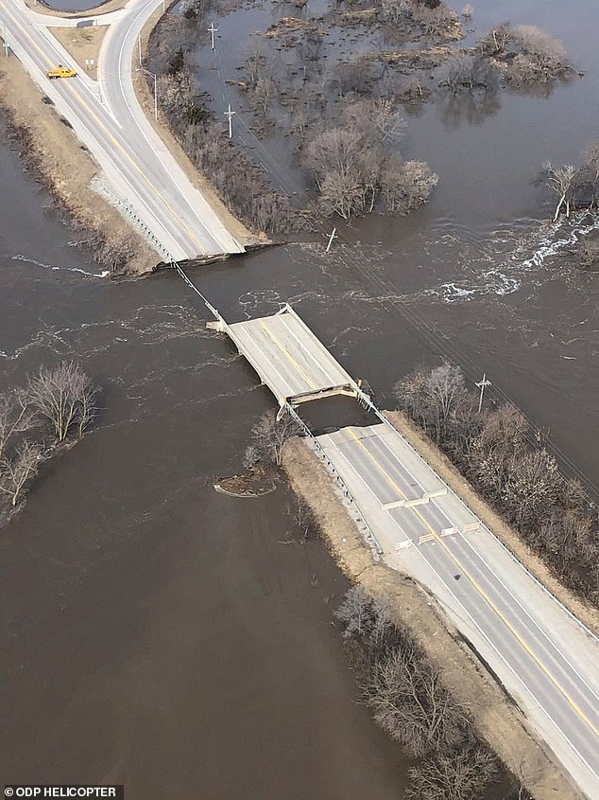
Applicability
Regulations are applicable to:
All encroachments
All actions affecting base floodplains
EXCEPT for repairs made with emergency funds (23 CFR part 668)
Source: US Hwy 275/Nebraska 92 bridge west of Elkhorn River, 2019
Notes:
Regulations are applicable to all encroachments and all actions affecting base floodplains with the exception for repairs made with emergency funds during or immediately following a disaster.
Emergency repairs are funded at 100% for the first 270 days after an event. All projects should advance to obligation within 2 fiscal years after the date of the event. All "permanent repairs" must comply with all federal requirements, which includes NEPA.

Slide 9
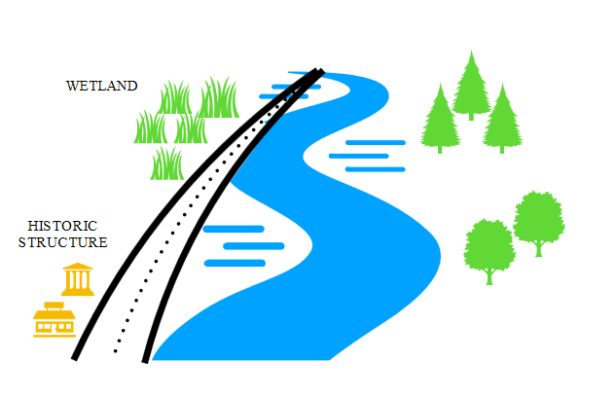
Policy
To avoid longitudinal encroachments, where practicable
Encroachments parallel to direction of flow
Source: AI Generated, Canva
Highway encroaching on floodplain
Notes:
What are longitudinal encroachments?
-encroachments that are parallel to the direction of flow
-A highway that runs along the edge of a river is usually considered a longitudinal encroachment
(Point to longitudinal encroachments on image)
What is practicable? Capable of being done within reasonable natural, social or economic constraints
So, you want to avoid actions within the base floodplain that are parallel to the direction of flow of the waterway within reasonable natural social or economic constraints.
Does anyone know what a transverse encroachment is?
-Crossing a floodplain at an angle of 30 to 90 degrees, like this bridge crossing right here (point to bridge)

Slide 10
Policy
To avoid significant encroachments, where practicable
Interrupts or terminates emergency or evacuation routes
Causes loss of human life or damage to property
Adversely impacts floodplain values
Source: AI Generated, Canva
Notes:
We remember what encroachments are? Actions within the limits of a base floodplain. So, what makes them significant?
A significant encroachment is any highway encroachment and any likely base floodplain development that would involve one or more of the following impacts:
1) potential for interrupting or terminating emergency or evacuation routes
2) causing a risk of loss of human life or property damage during the life of the highway
3) Causes adverse impacts on floodplain values (fish, wildlife, plants, outdoor recreation, etc)
The term significant is defined the same way as is used in NEPA A project with significant encroachment must be processed as an EIS. Keep in mind that an improvement proposed on an existing alignment that does not worsen the existing flood hazard would not normally be considered as a significant encroachment since the determination of a significant encroachment is based on proposed Federal action and not on existing transportation facility.
Bottom line on 650.111(c) - NEPA documentation needs to provide the "facts" that allows the "conclusions" about implementation, floodplain values, incompatibility, impact minimization, and those measures.

Slide 11
Location Hydraulic StudY
23 CFR §650.111
NFIP maps
Practicality of alternatives
Discussion, commensurate with risk:
Implementation
Impacts on floodplain values
Incompatible floodplain values
Measures to minimize impacts
Measures to restore floodplain values
Practicality of alternatives to significant encroachments or any support of incompatible floodplain development
Source: I-10 Lake Charles (i10lakecharles.com)
Notes:
Oh-wah, you think you're special Oh-oh, you think you're something else Okay, so you’ve got an encroachment? That don't impress me much…
You just have to do a Location Hydraulic Study. LHS are performed to evaluate a base 100 yr flood and the proposed impact(s) on the base floodplain. The study involves using Flood Insurance Study data and National Flood Insurance Program (NFIP) maps for baseline and a hydraulic model to determine the new BFE (if any). Information from the LHS must be summarized in your Environmental Document.
LHS consists of:
Use of National Flood Insurance Program (NFIP) maps or information developed by the highway agency shall be used to determine if there will be an encroachment. (Now we all remember what an encroachment is, right? Action within a base floodplain)
There should be an evaluation and discussion of the practicality of alternatives to any longitudinal alternative (parallel to the direction of flow)
Commensurate with the risk or environmental impact, for all alternatives that includes an encroachment and for those actions that would support base floodplain development, you have to discuss:
Ricks associated with implementation
Impacts of natural and beneficial floodplain values, such as fish, wildlife, outdoor recreation, groundwater recharge
Support of incompatible floodplain development
Measures to minimize floodplain impacts due to the action
Minimization measures to floodplain impacts due to the action
Evaluation and discussion of practicality of the alternatives to any significant encroachments or any support of incompatible floodplain development

Slide 12
Location Hydraulic StudY
23 CFR §650.111
NFIP maps
FEMA Flood Map Service Center: https://msc.fema.gov/portal/home
Community Status:
Community Status Book | FEMA.gov
Notes:
National Flood Insurance Program (NFIP) maps or information developed by the highway agency shall be used to determine if there will be an encroachment.
-Go to FEMA Flood Map Service Center to find your official flood map; super easy, just type in address or town and zoom into your project area
Let’s see a simple floodmap. What is an indicator that there is water around? Yep, that blue outside of water. You see it designated as Zone A. That’s your base floodplain or areas with 1% annual chance of flooding. Because detailed analysis are not performed in these areas; there are no base flood elevations within this zone.
Do you see the Zone X? Those are areas of moderate flood hazard, between 100 and 500 yr floods.
See the Green #s? That’s the map # and the effective date. It tells you this flood map here has regulatory authority when that date is effective.
*basically, you look up to see if there is a FEMA NFIP mapped area. Cite the most recent FEMA FIRM to comply with this section. This can be as simple as “A review of the current effective FEMA NFIP maps (dated XYZ) indicates portion of the project are within the base floodplain.”
Unidentified floodplain
-no maps identifying 100 year floodplain
-community is not in NFIP
-discuss any significant impacts
-summarize location hydraulic study and provide floodplain documentation

Slide 13
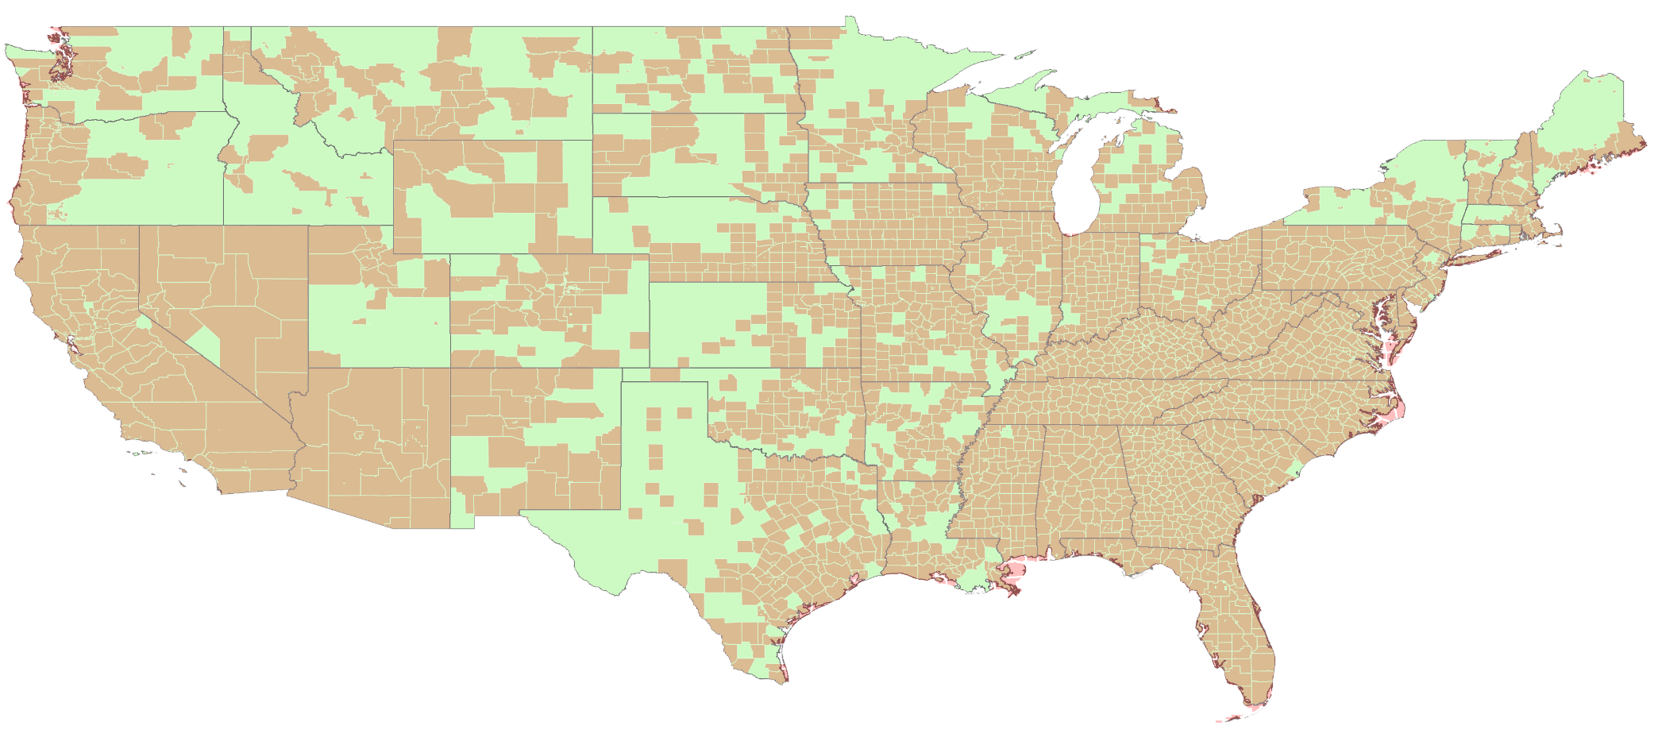
Location Hydraulic StudY
23 CFR §650.111
No NFIP maps?
Unmapped by FEMA:
Federal Lands
1.1 million stream miles
Non-Federal Lands
1.3 million stream miles
Solution?
Maps developed by Highway Agency
Notes:
There are over 1.3 million stream miles and almost just as much in non-federal lands that are unmapped by FEMA. Keep in mind that a lot of these stream miles in Tribal lands are also unmapped.
So, what do you do when you have a project that doesn’t have any NFIP maps? You have to rely/request maps developed by the state highway agency.

Slide 14
Location Hydraulic StudY
23 CFR §650.111
NFIP maps
Notes:
Let’s look at this floodplain map at I-10 Lake Charles in Calcasieu, LA. Anything a little different in this map?
Notice the AE designation. That’s your base floodplain where base flood elevations are provided. The EL 9 means 9 ft is the level the surface water will likely reach during a base flood.

Slide 15
Location Hydraulic StudY
23 CFR §650.111
NFIP maps
Alternatives on longitudinal encroachments
A discussion of the practicality of alternatives to any longitudinal encroachment
Other alternatives considered and why not practicable to not encroach?
Statement whether action conforms to state and local floodplain standards
Source: google maps, 2024
Notes:
The current alignment has portions that are longitudinal encroachments (e.g., the land spur on the eastern approach of the bridge). Every alternative would continue to operate on this longitudinal encroachment. Attempting avoidance is not practicable for these locations.

Slide 16
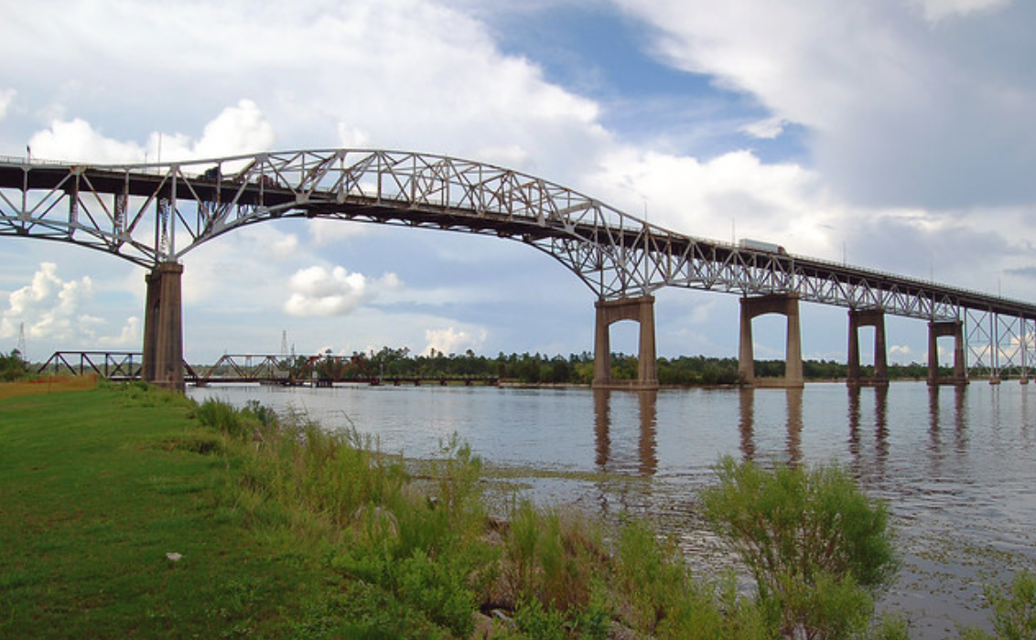
Location Hydraulic StudY
23 CFR §650.111
NFIP maps
Practicality of alternatives
Discussion, commensurate with risk:
Implementation
Impacts on floodplain values
Incompatible floodplain values
Measures to minimize impacts
Measures to restore floodplain values
Source: calcasieu-bridge.png (1132×700) (thehayride.com)
Notes:
This section includes discussion of the following items, commensurate with the significance of risk or environmental impact, for all alternatives containing encroachments and for those actions which would support base floodplain development. So, we are still working on the I-10 Calcasieu replacement bridge.
Risks on implementation
The risk associated with implementation of the proposed Project is negligible because water conveyances to receiving waters would be implemented and the extent of commercial and residential development in the base floodplain would be reduced through relocation of these activities outside of the base floodplain.
Impacts on natural and beneficial floodplain values (fish, wildlife, natural beauty, recreation, agriculture, etc)
2) The proposed Project would not impact natural and floodplain values but would offer some opportunity for improvement of natural and beneficial floodplain values by removing some existing development out of the base floodplain and allowing for a transition of that part of the floodplain to a more natural state.
Support of probable incompatible floodplain values
3) The proposed Project would not support incompatible floodplain development; it would reduce the extent of commercial and residential development in the base floodplain through relocation of these activities outside of the base floodplain.
Measures to minimize floodplain impacts associated with the action
4) Measures to minimize floodplain impacts associated with the action include implementation of water conveyances and reduction of the extent of development in the floodplain.
Measures to restore natural and beneficial floodplain values with the action
5) The proposed Project would not impact natural and floodplain values but would offer some opportunity to restore and preserve the natural and beneficial floodplain values.

Slide 17
Location Hydraulic StudY
23 CFR §650.111
NFIP maps
Practicality of alternatives
Discussion, commensurate with risk:
Implementation
Impacts on floodplain values
Incompatible floodplain values
Measures to minimize impacts
Measures to restore floodplain values
Practicality of alternatives to significant encroachments or any support of incompatible floodplain development
Source: FEIS I-10 Calcasieu
Notes:
Location studies shall include evaluation and discussion of the practicality of alternatives to any significant encroachments or any support of incompatible floodplain development.
This one really means how practical are other alternatives that don’t have significant encroachments?
(q) "Significant encroachment" shall mean a highway encroachment and any direct support of likely base flood-plain development that would involve one or more of the following construction-or flood-related impacts:
(1) A significant potential for interruption or termination of a transportation facility which is needed for emergency vehicles or provides a community's only evacuation route.
(2) A significant risk, or
(3) A significant adverse impact on natural and beneficial flood-plain values.

Slide 18
Location Hydraulic StudY
23 CFR §650.111
NFIP maps
Practicality of alternatives
Discussion, commensurate with risk:
Implementation
Impacts on floodplain values
Incompatible floodplain values
Measures to minimize impacts
Measures to restore floodplain values
Practicality of alternatives to significant encroachments or any support of incompatible floodplain development
NEPA document summarizes items (c) and (d)
Notes:
(e) Making sure the location study (everything you did in A-D) is documented in your NEPA document

Slide 19
Location Hydraulic StudY
23 CFR §650.111
NFIP maps
Practicality of alternatives
Discussion, commensurate with risk:
Implementation
Impacts on floodplain values
Incompatible floodplain values
Measures to minimize impacts
Measures to restore floodplain values
Practicality of alternatives to significant encroachments or any support of incompatible floodplain development
NEPA document summarizes items (c) and (d)
Floodplain agencies consultation
CLOMR/LOMR
[Conditional Letter of Map Revision/Letter of Map Revision]
Impacts or changes in regulatory floodplain
Local FP agencies may have more restrictive than the NFIP 1.0 ft rise criteria
0.0 ft rise criteria in Floodway
Notes:
(f) Ensure local, state, and federal water resources and floodplain management agencies are consulted to determine if the proposed highway action is consistent with existing watershed and floodplain management programs
Discussion with your local flood administrators should be done during the NEPA phase, not during the design phase, which has occurred in some EIS/EAs we have reviewed. Opens your way to possible litigation.
So, you go through the Location Hydraulic Study and have an encroachment and hydraulic modeling shows you may impact or change a regulatory floodplain (such as backwater)
Backwater is the increase in the upstream water surface level resulting from an obstruction to flow.
What happens next? The state DOT/stakeholder will be going through the CLOMR/LOMR process.
-CLOMR/LOMR – Conditional Letter of Map Revision and Letter of Map Revision
LOMR is a letter of FEMA officially revising the current NFIP maps to show changes to floodplains, regulatory floodways or flood elevations
CLOMR is a letter from FEMA commenting on whether a proposed project, if built as proposed, or proposed hydrology changes would meet minimum NFIP standards
FHWA can get involved in mitigation efforts if a Federal aid highway project will cause a BFE rise (so anything over that amount, FHWA can participate in)
Keep in mind that the CLOMR process can take up to about 6-12 months, with the LOMR up to another 6 months.

Slide 20
2323 CFR 650 Subpart A – Location and Design of Encroachments on Floodplains
23 CFR 650.113
Only Practicable Alternative Finding
FHWA finds that the proposed significant encroachment is the only practicable alternative
Why in floodplain?
Why other alternatives not practicable?
Statement of whether the action conforms to local/state floodplain protection standards
Policy
Location and Hydraulic Studies
Only Practicable Alternatives
Design Standards
Content of Design Standards
Notes:
This section is when FHWA finds that the proposed significant encroachment is the only practicable alternative.
Let’s go back to our I-10 Calcasieu example.
Is this portion of I-10 an evacuation route? Is it the only one? If so, then this is a significant encroachment
There is nothing wrong with being a significant encroachment, just as long as these facts is documented one way (or the other). In other words, unless there is an alternative that avoids the entire area (there isn’t one that I’ve seen), then there aren’t any practicable alternatives. In that case, 650.113 allows the DA to apply the “only practicable alterative” conclusion.
This is the area of NEPA documents where we see litigation. The EA or EIS documents states “There are no significant encroachments.” and the litigants argue about this, normally citing how the definition applies to their argument.

Slide 21
2323 CFR 650 Subpart A – Location and Design of Encroachments on Floodplains
23 CFR 650.115 Design Standards
23 CFR 650.117 Content of Design Standards
Not part of NEPA and CANNOT be delegated!
If there is an Encroachment:
1. Risk Analysis/Assessment of Design Alternatives
a. Greater of Overtopping or Base Flood
b. Greatest Flood through Drainage Structure
2. Interstate, Flood ≥ 2%
3. Freeboard
4. Effects of channels, levees, and reservoirs considered
5. Design consistent with NFIP standards
Policy
Location and Hydraulic Studies
Only Practicable Alternatives
Design Standards
Content of Design Standards
Notes:
Now, the final 2 parts of 23 CFR 650 Subpart A are 115 Design Standards and 117 Content of Design Standards.
115 goes into detail the requirements for the design standard for an encroachment. These are criteria that your bridge designers need to heed for project design.

Slide 22
2323 CFR 650 Subpart A – Location and Design of Encroachments on Floodplains
23 CFR 650.117 Content of Design Standards
Detail of study commensurate with the risk
Studies contain:
1. Hydrologic & hydraulic data & computations
2. Risk analysis
3. Reasons why FEMA criteria inappropriate (Federal Lands)
Project plans contain:
Magnitude & Location of Water Surface Elevations
Magnitude & Location of Base Flood
Policy
Location and Hydraulic Studies
Only Practicable Alternatives
Design Standards
Content of Design Standards
Notes:
And 117 goes into what these design studies shall contain.
These are more for your hydraulic engineers when designing these encroachments.

Slide 23
What is this FFRMS?
Federal Flood Risk Management Standard
Where Are We Now?
EO 13690 established the FFRMS
EO 14030 reestablished the FFRMS
Nature based solutions
Redefining the base floodplain to account for climate conditions
Interim Guidelines
Rulemaking
USDOT Order 5650.2
23 CFR 650 Subpart A (revision)
Notes:
EO 13690 amended EO 11988
EO 14030 reestablished FFRMS
FFRMS takes into account changing flood hazards due to climate change and other processes (e.g., land use), redefining the base floodplain using one of three approaches to determine the vertical flood elevation and corresponding horizontal extent of the floodplain. (i.e., the FFRMS floodplain).
Encourages all actions to determine if it’s within FFRMS floodplain (area subject to flooding based upon using 1 of 3 methods: 1) climate informed science (CISA) with the elevation and flood hazard area resulting from climate informed science approach and best available hydrologic and hydraulic science. 2) Freeboard: 2 ft above non critical and 3 ft BFE for critical actions, 3) 500 yr flood.
Keep in mind that State DOTs in regard to FHWA actions need to abide by 23 CFR 650 Subpart A until any rulemaking to update 23 CFR 650 subpart A becomes official.
Essentially, no non-Federal entity needs to comply with EO 11988 or 13690. Why? Those EOs require Federal agencies to implement any requirements via their specific regulation or orders.
Specifically, at this time, there is no FHWA or USDOT requirement for actions to apply the Federal Flood Risk Management Standard (FFRMS).
USDOT is still drafting the means to achieve such implementation, but that will take time and public involvement to achieve.
Therefore, any highway actions need to comply with the FHWA’s floodplain regulation “23 CFR 650 subpart A” . 23 CFR 650 A is how FHWA complies with EO 11988].
There ARE other Federal agencies (FEMA) that had rulemaking implementing FFRMS. However, those regulations would not apply to FHWA funding or activities.
Interim Guidelines under review with Administration
New Floodplain Management and Protection Rulemaking – requirements that USDOT actions must consider evaluating proposed transportation infrastructure withing a designated floodplain
Updating USDOT Order 5650.2 to reflect the EO 13690, FFRMS and the Rule
Operating administrative updates to policies and programs, 23 CFR 650 Subpart A

Slide 24
Summary
Encroachment (Significant) on Floodplains
23 CFR 650 Subpart A

Slide 25
Thank you!
Susan Jones/Joe Krolak
FHWA, Office of Bridges and Structures

